Slide 1

DEMO
Frenkel Alex
Github: alexfrenkel92
03.02.2020

Slide 2

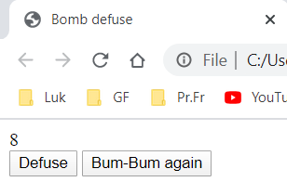
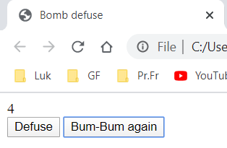
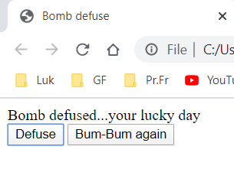
Bomb Defuse exercise + Rearm button

Slide 3
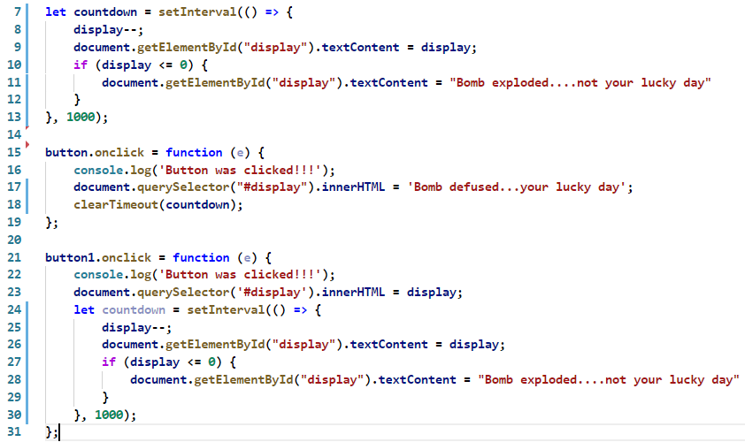
The code 1.0

Slide 4
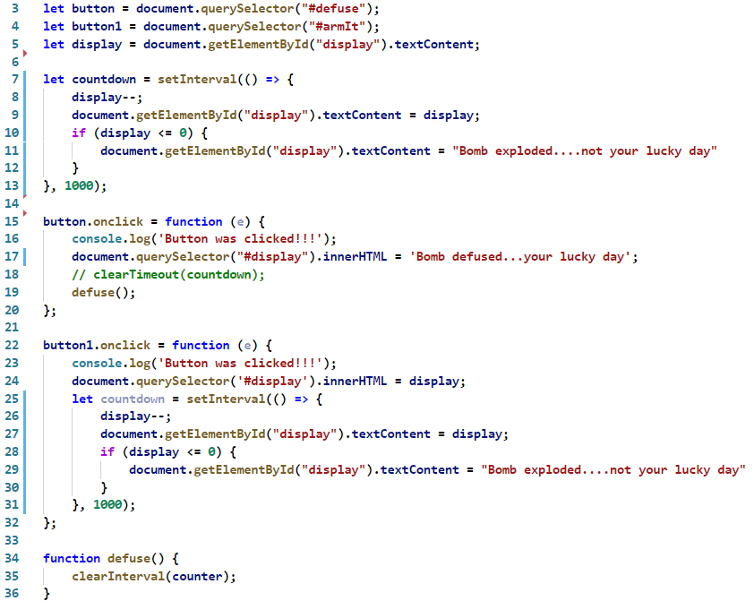
The code 1.1

Slide 5
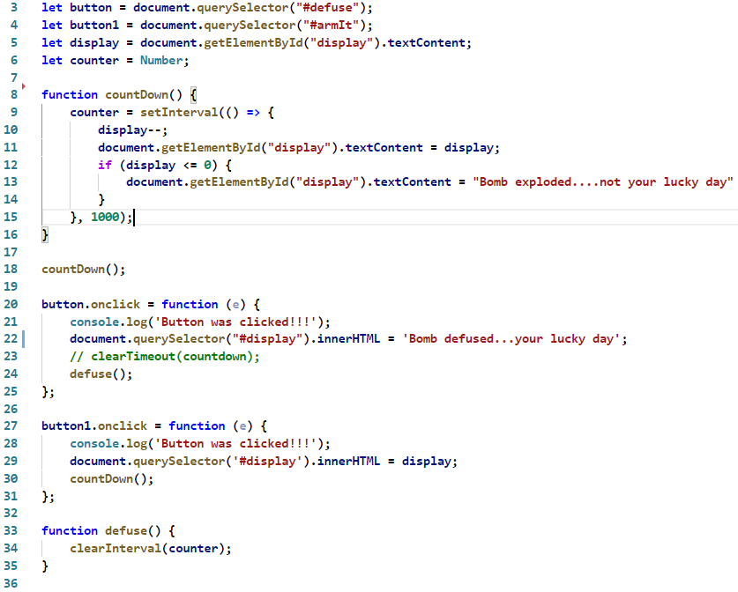
The code 1.2

